Slide 1
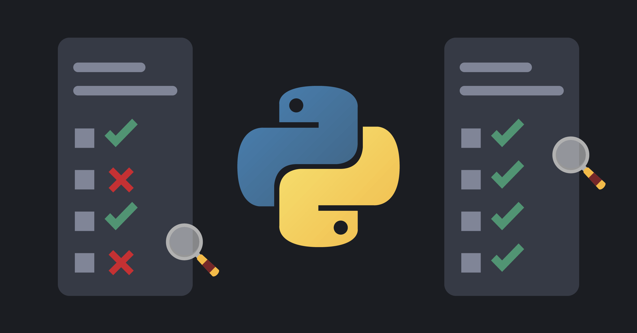
Welcome & Module Induction
What we learned previously: In Module 13, we mastered Asynchronous Programming, allowing our code to handle thousands of connections without blocking.
What we are learning today: We are learning how to prove our code works. We will explore Unit Testing (the foundation), Pytest (the industry standard), and Mocking (simulating the world).
Why this will be helpful: In a professional lab, you don't "hope" your code works; you "verify" it. If you update a function in your AI pipeline, how do you know you didn't accidentally break something else? Automated tests allow you to hit one button and check 1,000 logic points in seconds.

Slide 2
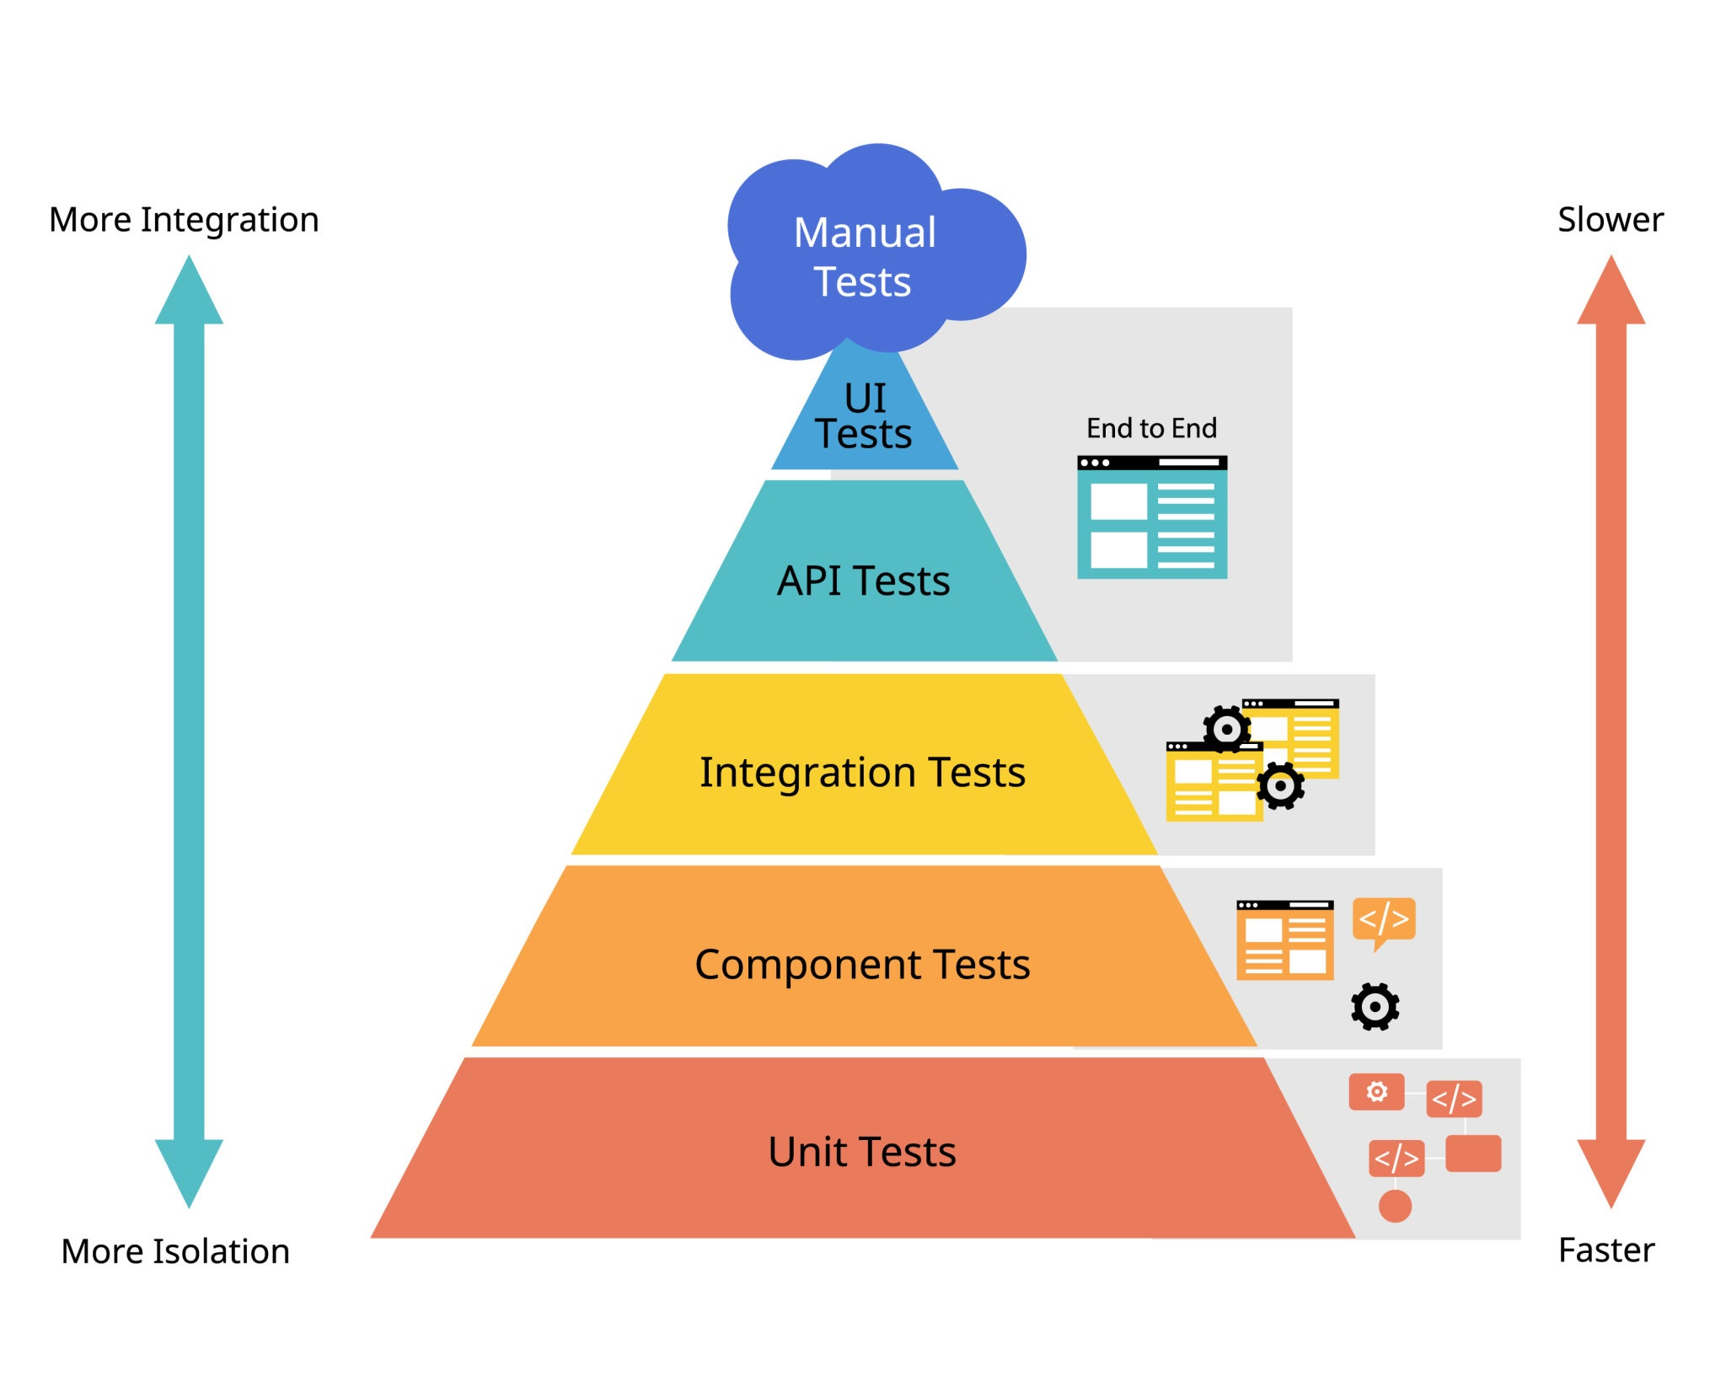
Unit Testing & the unittest Library
The Concept: A "Unit" is the smallest piece of testable code (usually a single function).
The Foundation: unittest is built directly into Python. It uses a "Class-based" approach where you define what a "Success" looks like using Assertions (e.g., assertEqual, assertTrue).
The Cycle: Test => Fail => Write Code => Pass.

Slide 3
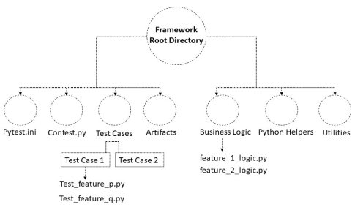
Professional Testing with Pytest
Why Pytest? While unittest is good, pytest is faster, more powerful, and easier to read. It allows you to use simple assert statements instead of complex method calls.
The Industry Standard: 90% of professional Python projects use Pytest because it can automatically find and run all your tests with a single terminal command.

Slide 4
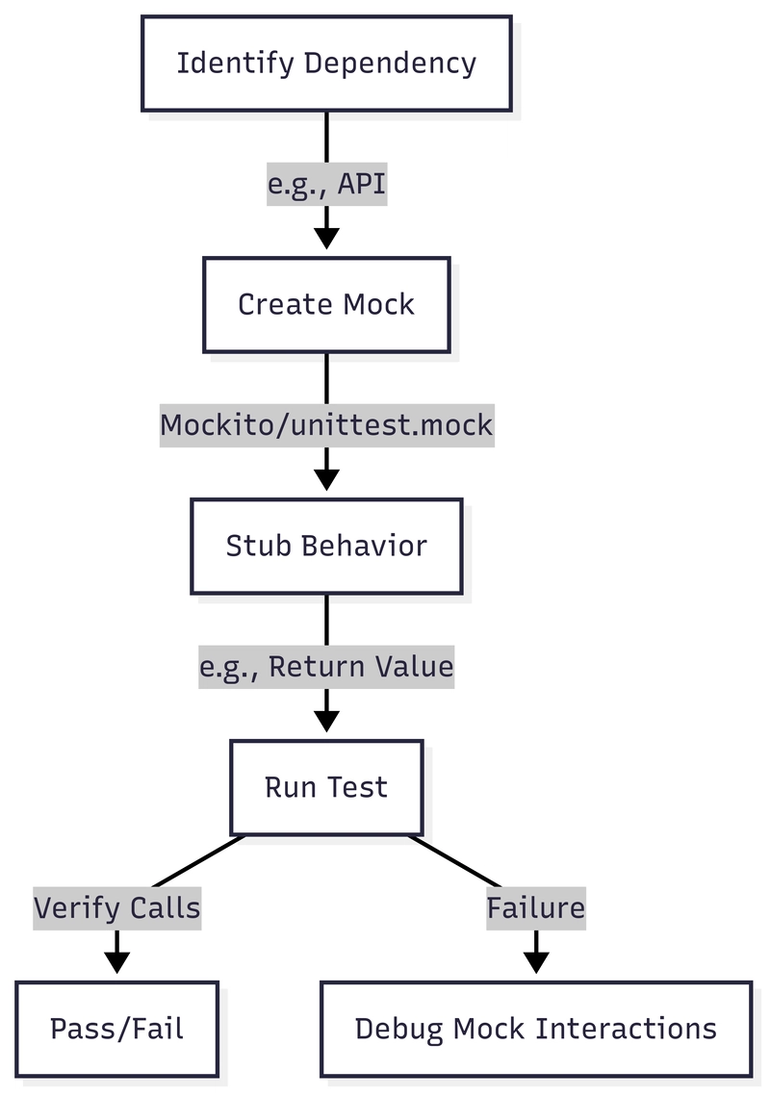
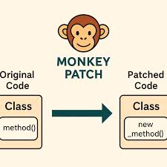
Mocking & Patching (The "Flight Simulator")
The Problem: How do you test a function that sends an email, deletes a database, or calls an expensive OpenAI API? You don't want to actually send 100 emails every time you run a test.
The Solution: Mocking. We create a "Fake" object that mimics the behavior of the real one.
The Analogy: It’s like a flight simulator. The pilot can practice landing in a storm without actually risking a million-dollar airplane.

